Slide 1

Department of Collegiate and Technical Education
AUTOMATION AND ROBOTICS(V Semester)
WEEK 5 DAY 2
SESSION 3
Electronics and Communication Engineering

Slide 2
Contents
➢ Typical Network Architecture
➢ Network Cables &accessories
➢ Use of Fibre Optic Cables

Slide 3
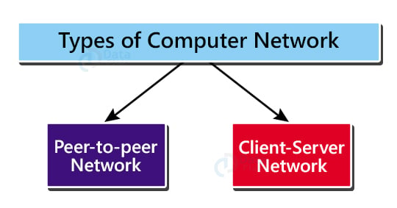
Computer Network Architecture
The design and setup of a computer network is called Computer Network Architecture. It is the organization and arrangement of different network devices (i.e., the clients such as PCs, desktops, laptops, mobiles etc.) at both physical and logical levels in order to fulfil the needs of the end user/customer
Electronics and Communication Engineering-20EC53I

Slide 4
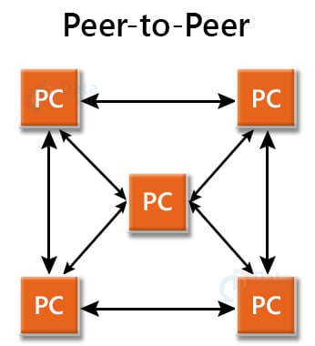
•Peer-to-peer Architecture:
The peers referred to here are the individual devices linked together directly, having equal responsibilities and equal powers without the presence of any central authority.
Due to the absence of a central device in charge of tasks, this architecture is also known as decentralized architecture.Each computer has special rights for resource sharing, however this might cause issues if the computer with the resource is unavailable.
Useful in smaller environments with less number of computers

Slide 5
Advantages of Peer to Peer Network:
No particular device is a client or a server, the tasks and responsibilities of servers are distributed among all the devices, which also act as clients.
Very inexpensive to set up, as there is no requirement of a centralized server, and this also ensures that in case of any failure in the network, all unaffected devices continue to operate normally.
It’s simple to set up and maintain because each computer runs independently

Slide 6
Disadvantages of Peer to Peer Network:
No centralized system, thus difficult to keep a backup of the data in case of any fault.
It has a security flaw because the computers are self-managed.
With a growth in the number of machines on this network, performance, security, and access may all become big issues

Slide 7
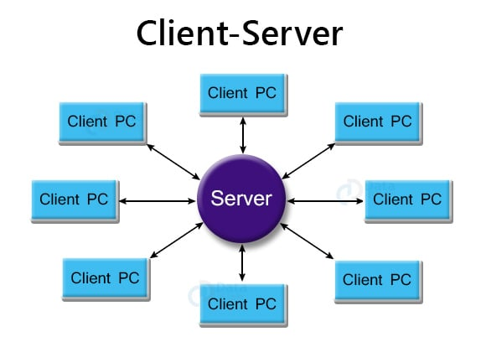
2.Client-Server Architecture

Slide 8
Client-Server Architecture
This is also known as centralized architecture, as one powerful central computer is in charge of serving all the requests from the client computers. This central computer is a server.
The client computers connect to the server as and when they require the use of shared resources or shared data. All of the shared data is stored solely in the server, and not on any other computer.
A server handles all of the key tasks, such as security and network administration.
All of the clients interact with one another via a server

Slide 9
Advantages of Client-Server Architecture:
This type of architecture is much easier to scale since it is much more convenient to add more server computers than configure the network on each and every computer (as is the case in peer-to-peer architecture).
Much faster network speeds.
Because a single server manages the shared resources in a Client/Server network, there is improvement in security.
Backing up data is easy because of the centralized system.
The server provides a customized Network Operating System (NOS) to offer resources to a large number of users that want them.

Slide 10
Disadvantages of Client-Server Architecture:
More prone to downtime because if the server fails, none of the client machines are able to get their requests served.
Requirement of a dedicated network administrator to handle all of the resources.
It is far more expensive than P2P. This is due to the requirement for a server with more RAM, as well as the necessity for several networking devices such as hubs, routers, switches, and so on.

Slide 11
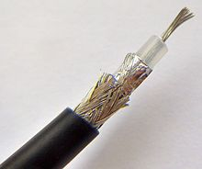
Networking cables
Coaxial cables
Coaxial cables form a transmission line and confine the electromagnetic wave to an area inside the cable between the center conductor and the shield.
The transmission of energy in the line occurs totally through the dielectric inside the cable between the conductors.
Coaxial lines can therefore be bent and twisted (subject to limits) without negative effects, and they can be strapped to conductive supports without inducing unwanted currents in them

Slide 12
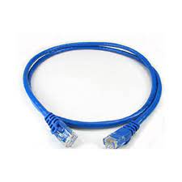
Patch cable
A patch cable is an electrical or optical cable used to connect one electronic or optical device to another for signal routing.
Devices of different types (e.g. a switch connected to a computer, or a switch connected to a router) are connected with patch cables. Patch cables are usually produced in many different colors so as to be easily distinguishable, and most are relatively short, no longer than a few meters.[citation needed] In contrast to structured cabling, patch cables are more flexible

Slide 13
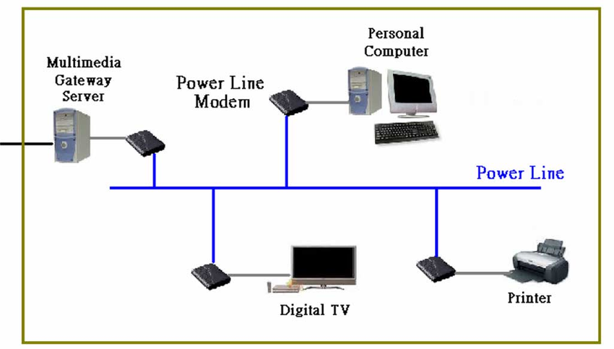
Power lines

Slide 14
Power lines
power line communication (PLC) allows these wires to also be used to interconnect home computers, peripherals or other networked consumer products. The HomePlug protocol family was an early PLC technology. In December 2008, the ITU-T adopted Recommendation G.hn/G.9960 as the first worldwide standard for high-speed power-line communications.also specifies techniques for communications over the existing category 3 cable used by phones and coaxial cable used by cable television in the home

Slide 15
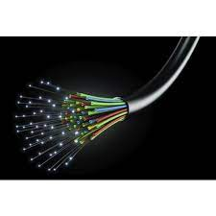
Fibre Optic Cables
A fiber-optic cable is composed of very thin strands of glass or plastic known as optical fibers; one cable can have as few as two strands or as many as several hundreds of them.
These optical fiber cables carry information in the form of data between two places using optical or light-based technology.
Once the light beams travel down the optical fiber cable (OFC), they would emerge at the other end.
A photoelectric cell will be required to turn the pulses of light back into electrical information the computer can understand

Slide 16

Uses of Optical Fibers: Medical Industry:
Due to the highly flexible and thin nature of fibre optic cables, it is used in several types of instruments. Fibre optic wires are heavily used in the area of both medicines as well as research. It helps in getting an inside view of the body.
With the help of optical fibre, a doctor can view the internal parts of the body. This is done by inserting these fibers into the empty areas in the body. Optical fibre serves as a laser during performing a wide range of medical treatments that include surgeries, biomedical research, and microscopy.

Slide 17
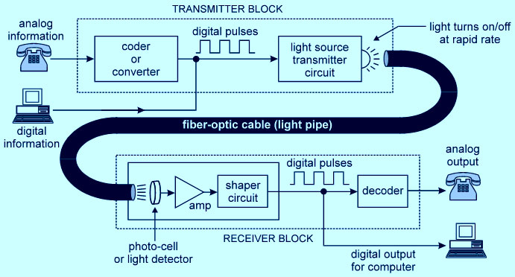
For Communication:
Fibre optic cables have the ability to send bulk amounts of information at blistering speeds. This technology is largely used in the formation of internet cables.
More and more communication industries are opting for optical fibers over traditional wires. This is for the reason that in contrast to copper wires, optic fibre wires are less heavy, carry more data and are more flexible.

Slide 18
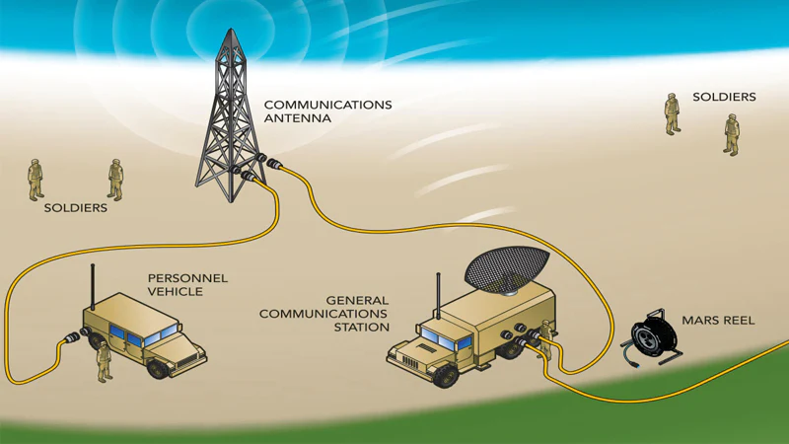
In Defence Purpose:
Defence is another significant area where optical fibers are extensively used.
These cables are suitable for the transmission of data in aerospace and military applications that require high data security.
Optical fibers present a sturdy and robust communication medium that makes them useful in creating wiring in aeroplane, hydrophones for Seismic s and SONARs purposes.

Slide 19
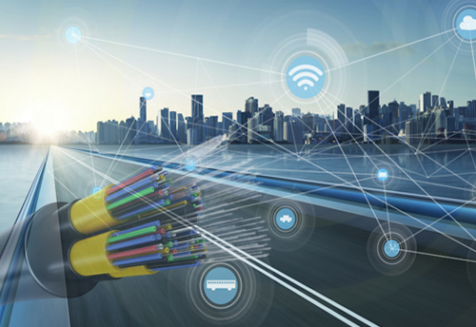
In Industries:
There are several industries that have benefited from the installation of optical fibers.
One of the areas where optical fibers are used extensively is “imaging”.
It is most appropriate for places that are tough to reach.
These fibers are used for lighting purposes and safety measures in designing the interior and exterior of automobiles.

Slide 20
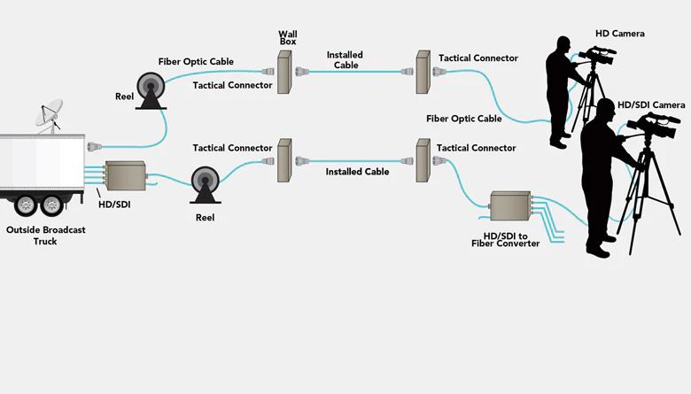
For Broadcasting:
Broadcasting is another area where optical fibre is widely used. These cables have the ability to broadcast television signals that are characterized by high speed and greater bandwidth. Companies that are into broadcasting signals make use of optical fibre for purposes that include video-on-demand, wiring CATV, HDTV, and several other applications.

Slide 21
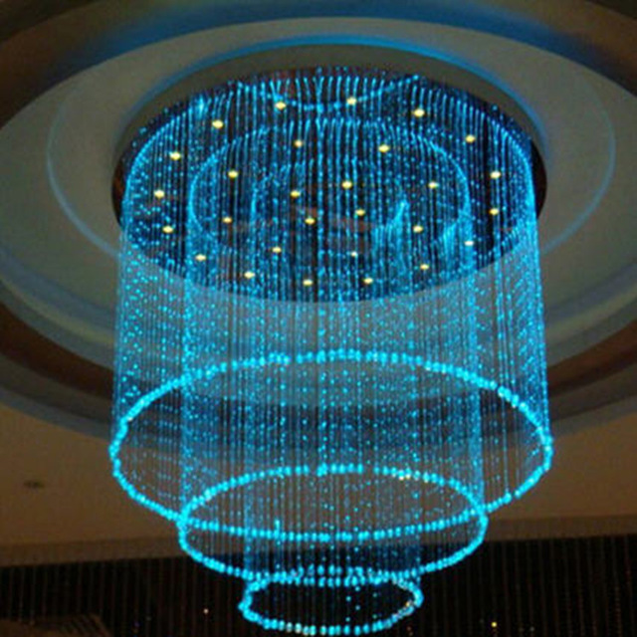
For Lightening and Decorations:
Optical fibre is seen to be a lucrative, convenient, and cost-efficient means to lighten the space. It is mostly used to decorate areas and illuminate objects
The application of fibre optics has increased in the field of decoration and illumination. It has increased over the past years. These cables offer an easy, attractive and economical solution to various types of lighting projects.

Slide 22
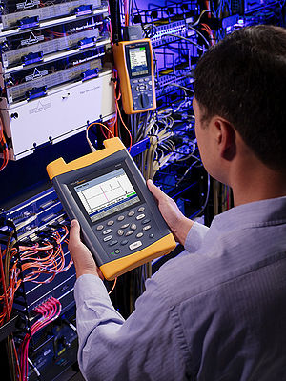
In Mechanical Inspections:
Onsite review engineers widely use optical fibre to figure out the fault or damage that is usually difficult to locate by simply looking at the object.
The plumbing industry is also not untouched by optical fibre. A lot of present-day plumbers and engineers use them for the evaluation of sewer, drain, and pipes.
With the help of these cables, they can easily detect any crack, damage, leakage, etc in the plumbing system quickly and easily. It is an effective and economical way to detect damage signs as compared to costly specialised tools.

Slide 23

THANK YOU
 | Name | College Name | College code
Moderator | Smitha G S | GPT,Channapatna | 111
Subject Experts | Savitha S | GPT, Ramanagara | 159
Content Developer | Roopa Y G | GPT, Chintamani | 107
Content Developer | Divyashree K L | GPT, Chintamani | 107
Content Developer | Shilpa M | GPT, Ramanagara | 159

